Slide 1
Sculptures

Slide 2
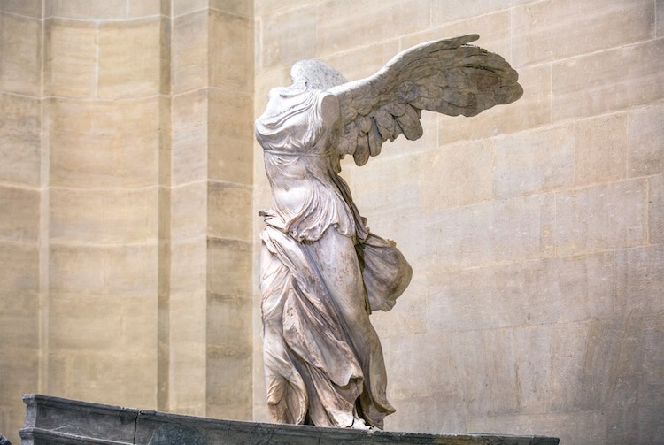
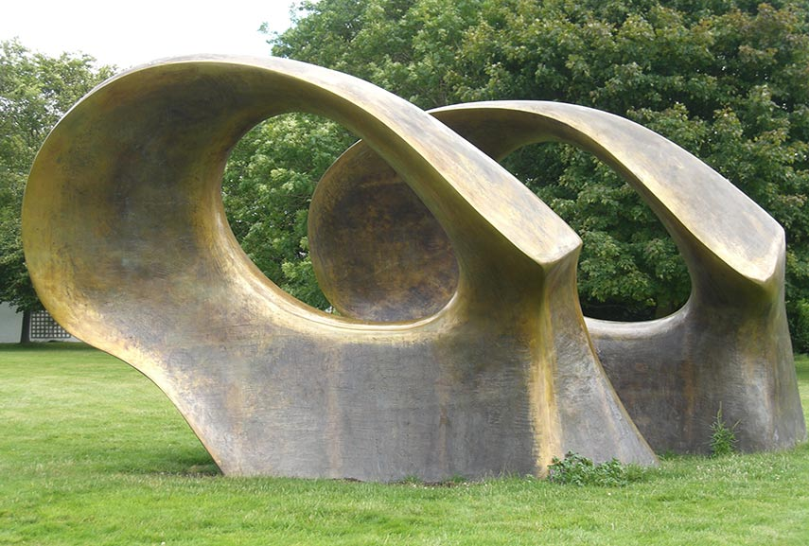
Investigating into sculptures
What is Sculpture?
Sculpture is the art of making three-dimensional representative or abstract forms, especially by carving stone or wood or by casting metal or plaster (Oxford Languages). There are different types of sculptures such as freestanding, reliefs on surfaces, or in environments ranging from tableaux ot contexts that envelop the spectator. Sculptures can be made in many different ways. You could carve, model, mold, weld or sew for example. Sculptures can be anything but the most common things that people made in history were people but they have also created things like books and games (Britannic).
What is form?
The literal definition of form is “the visible shape or configuration of something” (Oxford Languages). Form is one of the seven elements of art and basically means a 3-dimensional shape. There are different types of form such as geometric form and organic form. Geometric forms are forms that can be mathematical, precise and named; sphere, cube or pyramid are some examples.You can find a lot of these forms can be found in architecture or the built environment. Organic forms are forms that are free-flowing, curvy and are not symmetrically or cannot be easily named (Marder, 2020).
Fig. 2, widewalls, Organic sculpture
Fig. 1, Sam’s original art, Sculptures

Slide 3
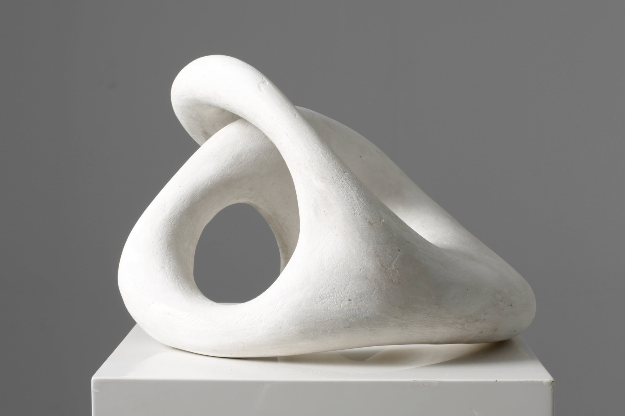
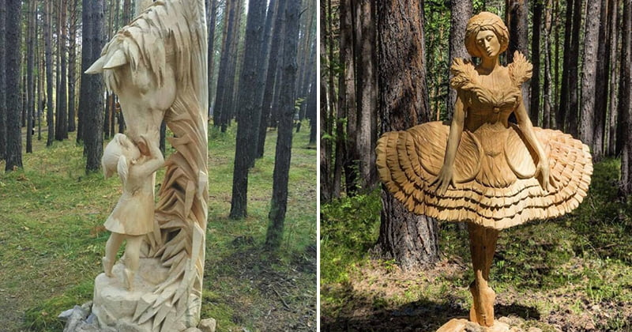
Investigating into sculptures
What different materials can be used to make sculptures?
Any material that can be shaped in three dimensions can be used to make a sculpture. There are different materials that work best and look aesthetically better than others so artists are more likely to use these than others. The typical materials are stone, clay, wood, metal, ivory and plaster (Britannica). These materials are used the most often because they are durable and somewhat easy to find. Anything can be used to create a sculpture but those materials are the most commonly used ones
What are the different purposes and functions of sculptures?
Sculpting has been around for a long time and they were originally used to represent god and kings who wanted to be immortalized had statues made to look like them. The main purpose sculptures have been given over the years include: Religion- in the past people have used sculptures to portray their religious beliefs. Honor- in honor of great people who have died or done good or wanted to be be immortalized have been made into statues. Sculptures represent many aspects of society making them great for symbolism. These objects serve as a reminder of what is, what was and what could be and this is why they are important in our lives (Skulpturhalle).
Fig. 4, Sauce, Plaster sculpture
Fig. 3, Bouncy mustard, Wooden sculptures

Slide 4
Types of sculptures

Slide 5
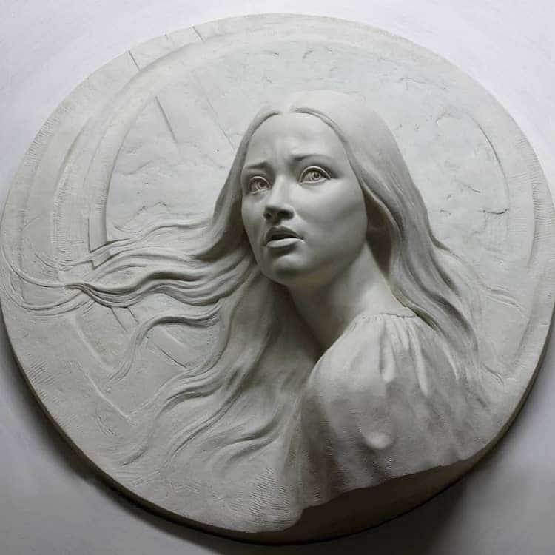
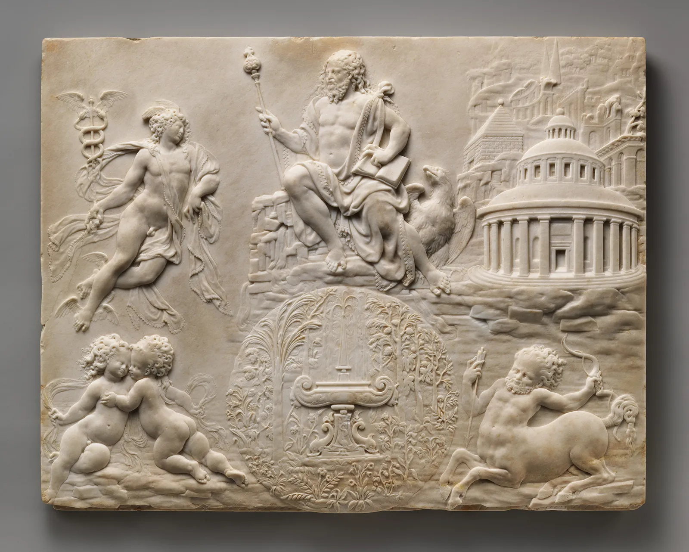
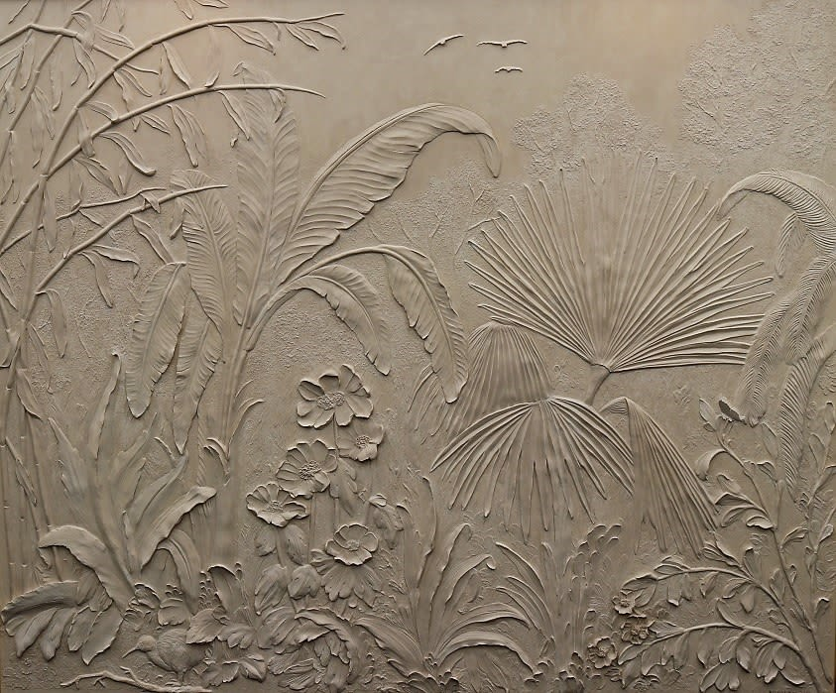
Relief sculptures
Relief sculptures, also known as relievo, is a sculpture where any figures project from a background. The reliefs are classified by how much they project from the background. In low relief sculptures, or base relief, the design projects only slightly from the background and there is little to no undercutting of outlines. In high relief the figures are projected out of the background a lot and some part may be completely disengaged. Middle relief fall in between high and low relief, so parts can be unattached but close to the background. There is another type of relief called sunken relief which was typically done by Egyptians. This type of relief is where the figures are sunken below the level of the surface and are outlined with a powerful line. Some artist that have created relief sculptures include Donatello and Giovanni Pisano. Donatello was an Italian sculptor during the renaissance period (Donatello). Giovanni Pisano was also an Italian sculptor and he worked mostly in the cities Pisa, Siena and Pistoia (Giovanni Pisano).
Fig. 5, My modern met, High relief sculpture
Fig. 6, Britannica, Middle relief sculpture
Fig. 7, Pigmentti, Low relief sculpture

Slide 6
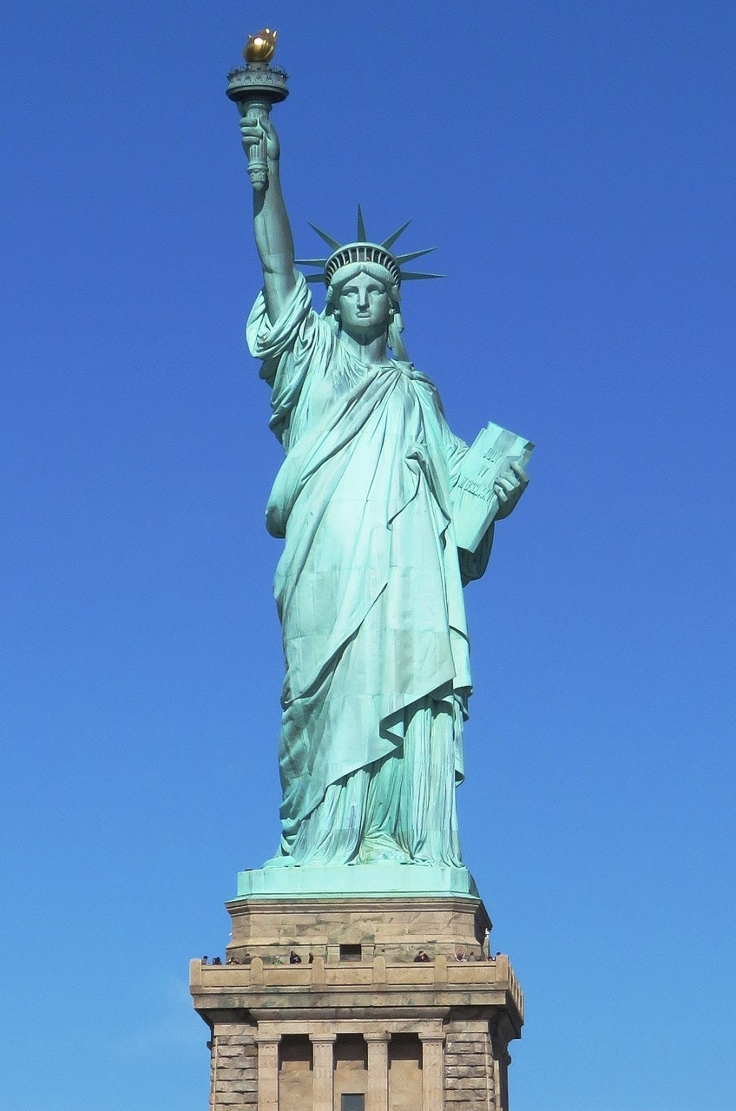
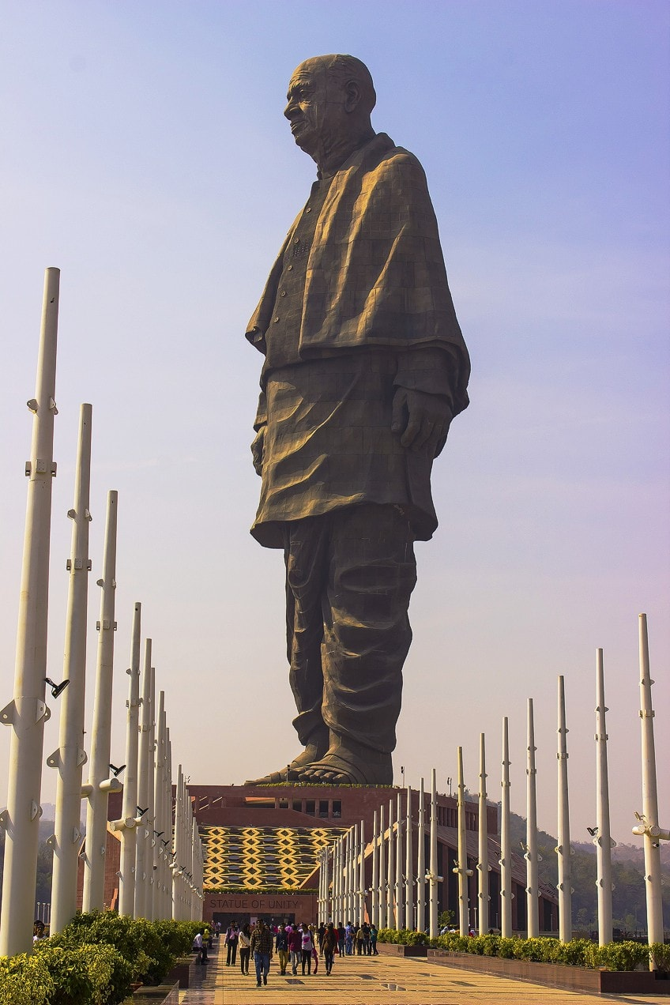
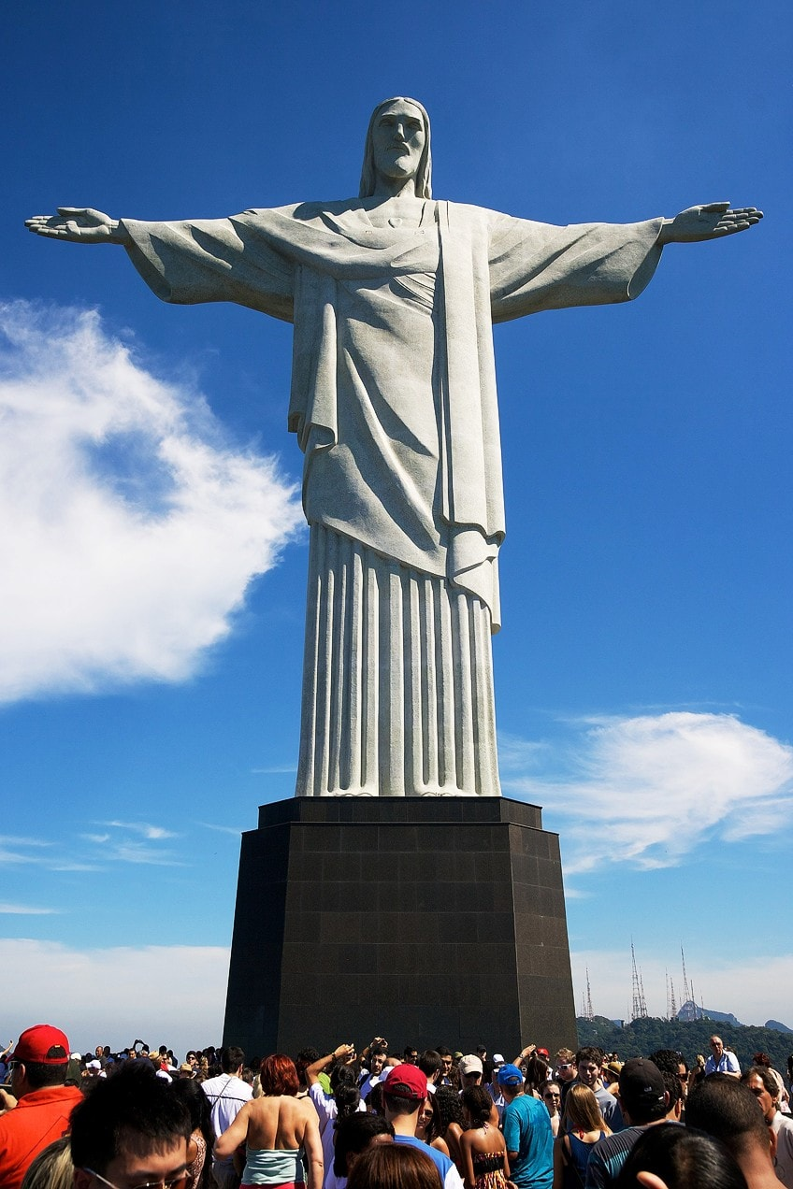
Full Round/Free-standing
Free-standing sculpture is a sculpture that is made to not be up against and wall and can be looked at from many different angles. These types of sculptures usually have a small base that the figure can stand on. The base is mounted on a plinth which is a small platform that serves as a pedestal. Sometimes freestanding sculptures are placed in public areas where everyone can view them but they can also be in private garden or museums. Some free standing sculptures are made specifically for public areas to serve as a memorial or a reminder of someone or something. The Statue of Liberty is one of the biggest and well known free standing sculptures. Free standing sculptures are usually made of wood, glass, metal or stone. An example of a free standing sculpture artist is Frederic Auguste Bartholdi, whos is the French sculptor who made the Statue of Liberty.
Fig. 9, Art in context, corcovado Christ the Redeemer
Fig. 10, Art in context, Free standing sculpture
Fig. 8, Art in context, Statue of Liberty

Slide 7
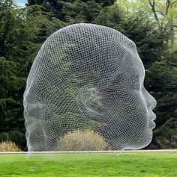
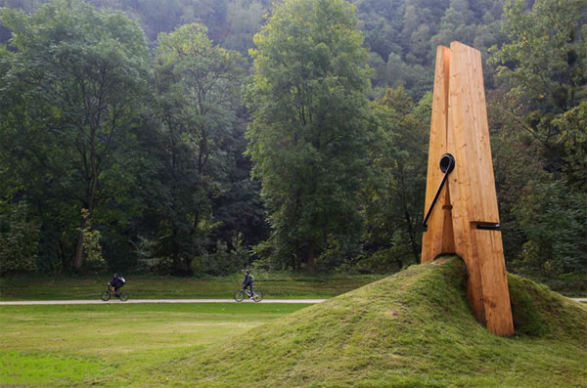
Installation/Site specific
The term installation is used to describe a large piece of art that is often designed for a specific place or for a temporary piece of time. When creating the sculpture the artist take the place it will be installed into consideration. If the sculpture is removed from that location it loses all it’s meaning. Site specific sculptures are generally found outdoor because they are usually quite big. You can find them in rural and urban spaces, landscapes, and natural environments but they can also be found in museums or exhibitions. This type of sculpture took hold in the 1960s, although it had been around before that, but soon spread internationally. Site specific sculpture was marked as a new, modern way of doing art. Richard Serra and Daniel Burren are two examples and site specific sculptures.
Fig. 11, Pinterest, Site Specific Sculptures
Fig. 12, Kathelarkin, Site Specific art

Slide 8
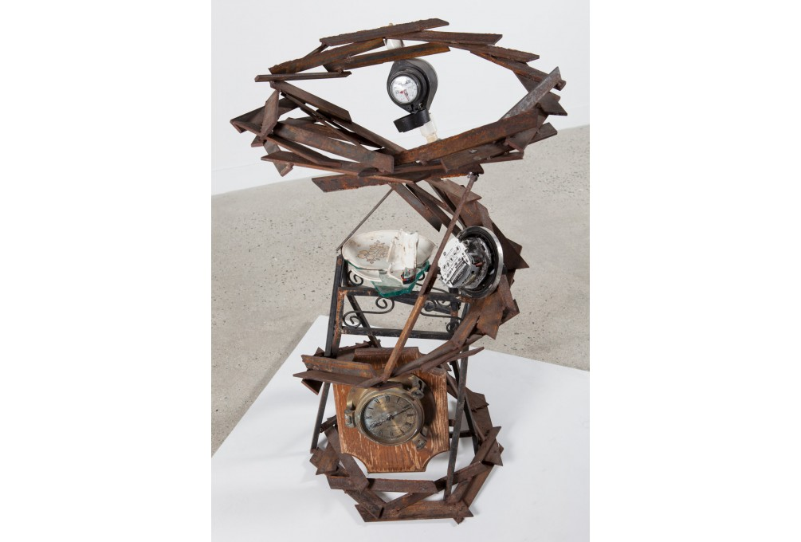
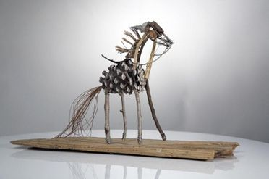
Assemblage
Assemblage is an art form of work produced by collecting everyday objects and arranging them to create something new. Each object used in the assemblage piece might be there for a symbolic meaning, aesthetic purposes, or to help hold the shape of the art piece. Assemblage is similar to the 2D art form, collage, but assemblage is 3D. Artists began exploring assemblage in the early 1900s. Assemblages had been called “Combines” and “Accumulations” until Jean Dubuffet re-named it in the 1950s. From then assemblage spread world wide and inspired many movements such as Pop art, Arte Povera and Installation art. Some of the earliest piece of assemblage art can be traced back to Pablo Picasso and Georges Braque, when they introduced different objects into their Synthetic Cubist paintings such as sand, rope and sawdust. Assemblage sculptures is beautiful and unique because it takes already found objects and creates something different out of it.
Fig. 14, National Gallery of the Cayman Islands, Art of Assemblage
Fig. 13, Artistry found, What is assemblage art?

Slide 9
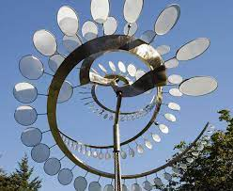
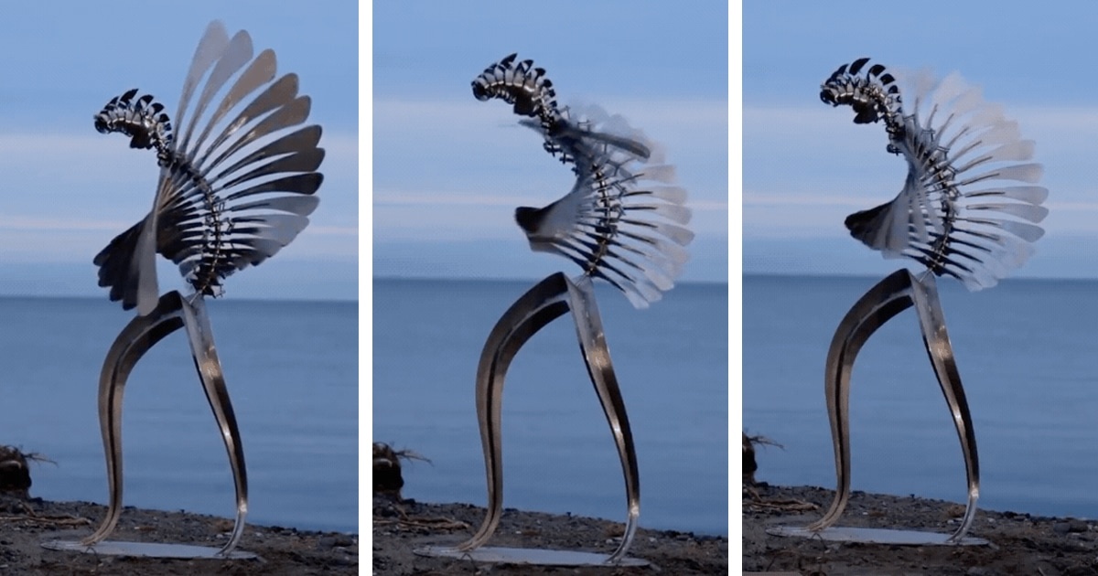
Kinetic
Kinetic sculpture is a sculpture where movement is a basic element. In the 20th century the use of movement in sculpture became and important aspect. Naum Gabo, Marcel Duchamp, Laszlo Moholy-Nagy and Alexander Calder were the pioneer of modern kinetic sculpture. There are many different varieties of kinetic sculptures which are moved in many different ways. Some can be moved by air currents, water, magnetism, electromechanical devices, or by the participation of the spectator. The aim of most kinetic sculptors is to make the movement itself an essential part of the design of the sculpture and not just movement to an already made object. A simple example of a kinetic sculpture is a mobile. Mobiles are controlled by wind movement and usually have objects on them that are constantly changing patterns.
Fig. 15, Inhabitant, Kinetic sculpture
Fig. 16, Anuariocidob, Kinetic sculpture

Slide 10
https://docs.google.com/document/d/1ZK1dUlgnlAaF8CfoM2MviCsecqfvcBt15oU25BvZ_KA/edit
Link for bibliography
(Because there were too many cites to fit on here)

Slide 11
First attempt at sculptures

Slide 12
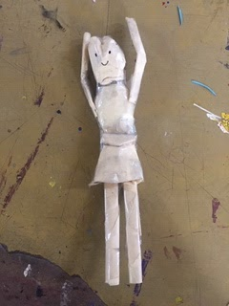
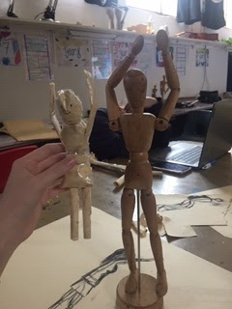
First attempt (in 20 mins)

Slide 13
How did it go?
I think my first attempt at making a sculpture went pretty well. We only had 20 minutes to make it with nothing but paper and tape. The mannequin had its hands over its head so that's how we had to make it look. It was pretty stressful because we didn’t have much time and not that many materials to work with. From this activity I have learned that sculpting is stressful. I also learned that to make it look good and realistic you have to kind of stuff it so it isn’t 2D. It’s also important to work from the bottom up so you have a base to work with. I’m really excited to make a sculpture and can’t wait to learn how to do it properly!

Slide 14
Planning my own sculpture

Slide 15
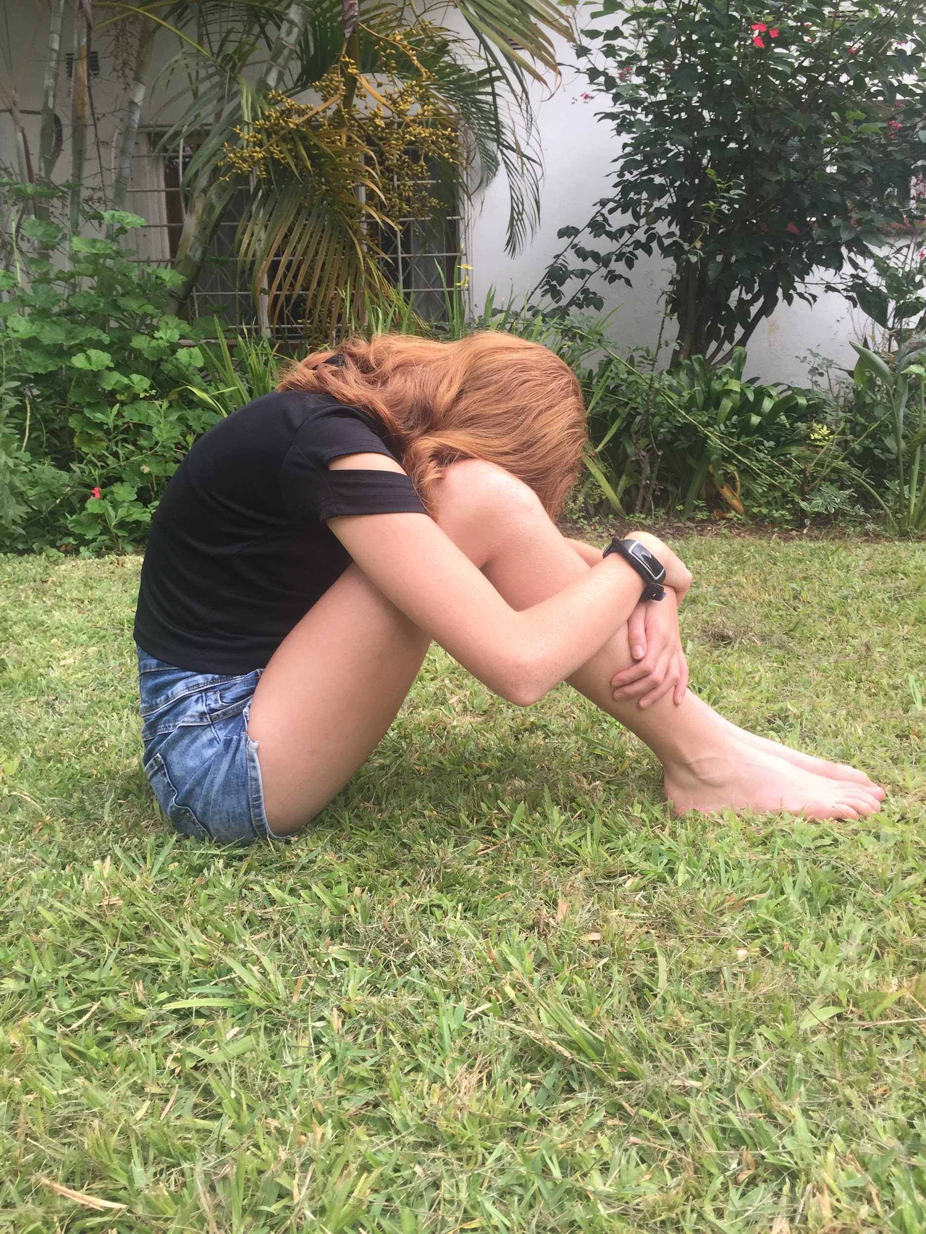
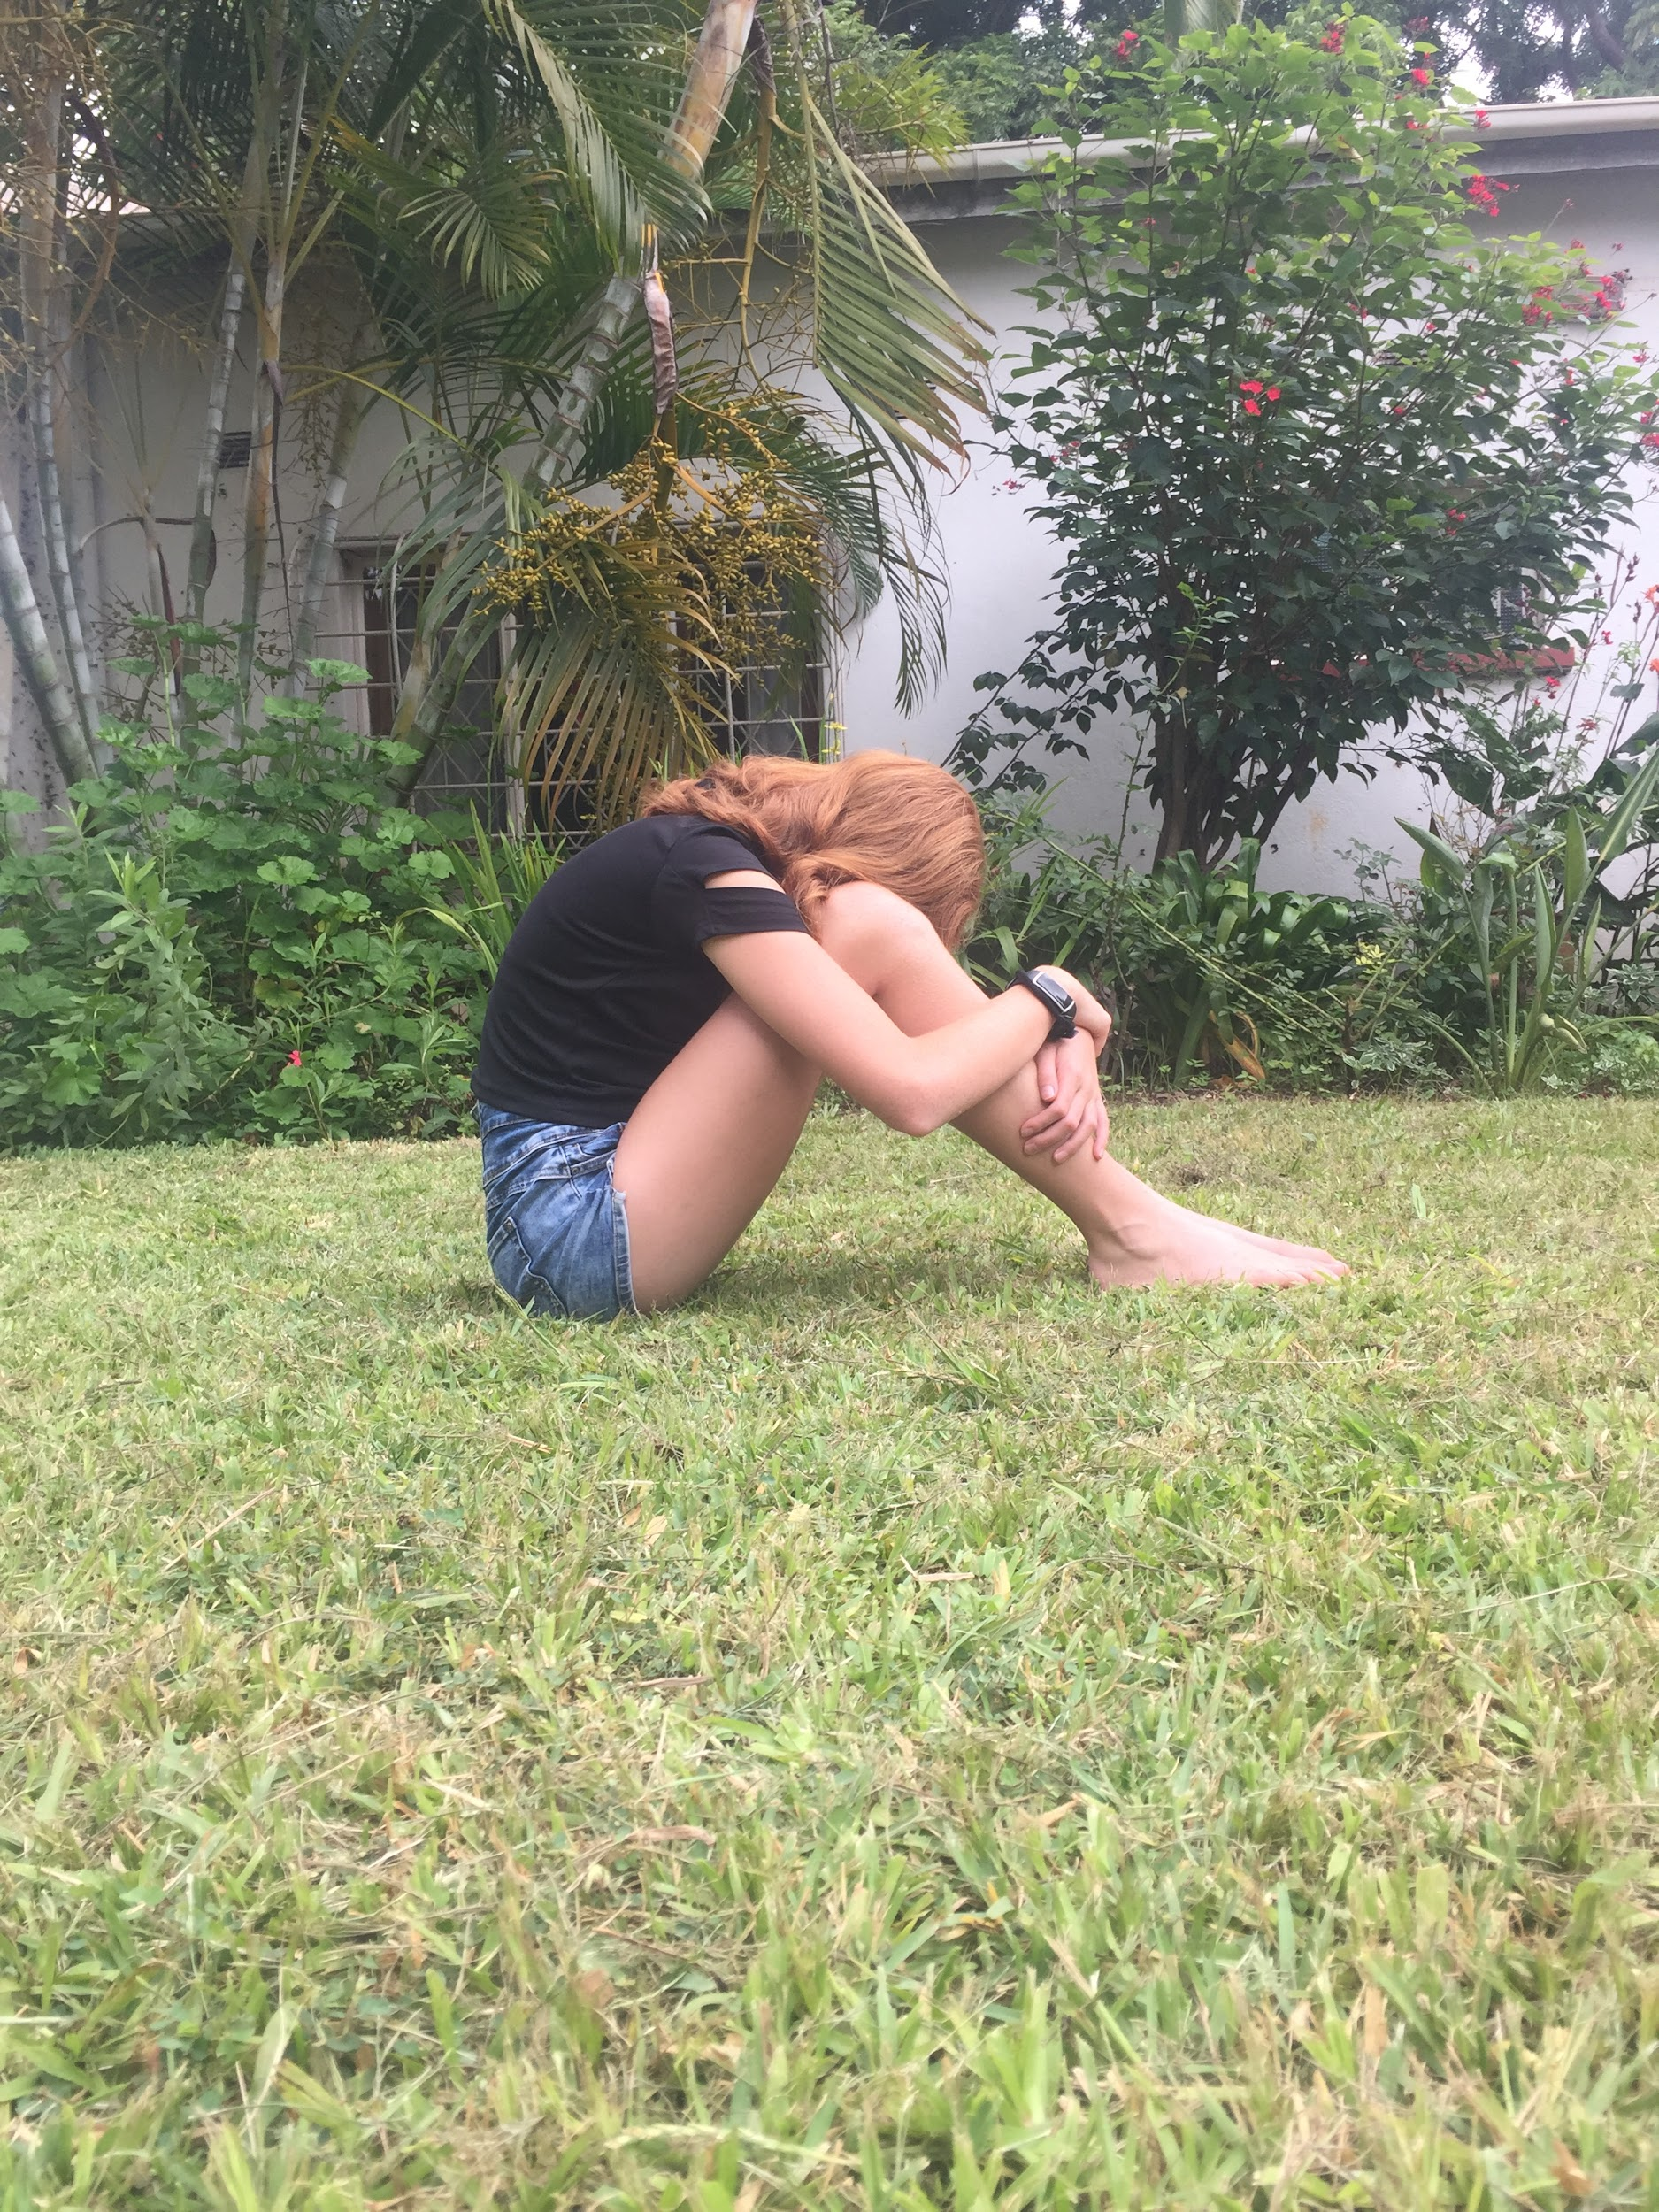
Emotions
How will you use human form to do this?
To show the sadness and loneliness my sculpture feels, I will have it sitting down and hugging it’s knees. To show the pain that the sculpture feels I want to have pins stuck into it, like each time it’s hurt it feels like someone stabbing them with a pin.
What message do you want to communicate?
I want to show others, through sculpture, how judgemental everyone is. People are constantly pointing out others flaws but don’t notice their accomplishments. Not everyone is like this but I want people to know that this isn’t okay and if you’re being hurt you’re not alone. There are people who can help and I want this sculpture to be a reminder. This sculpture will represent sadness and pain.
What materials will you use to create this?
I’ll need to use something that is strong to hold it’s shape but also able to stick pins in it. I’ll be using pins because it show pain like being stabbed with a pin everytime someone says something hurtful.

Slide 16
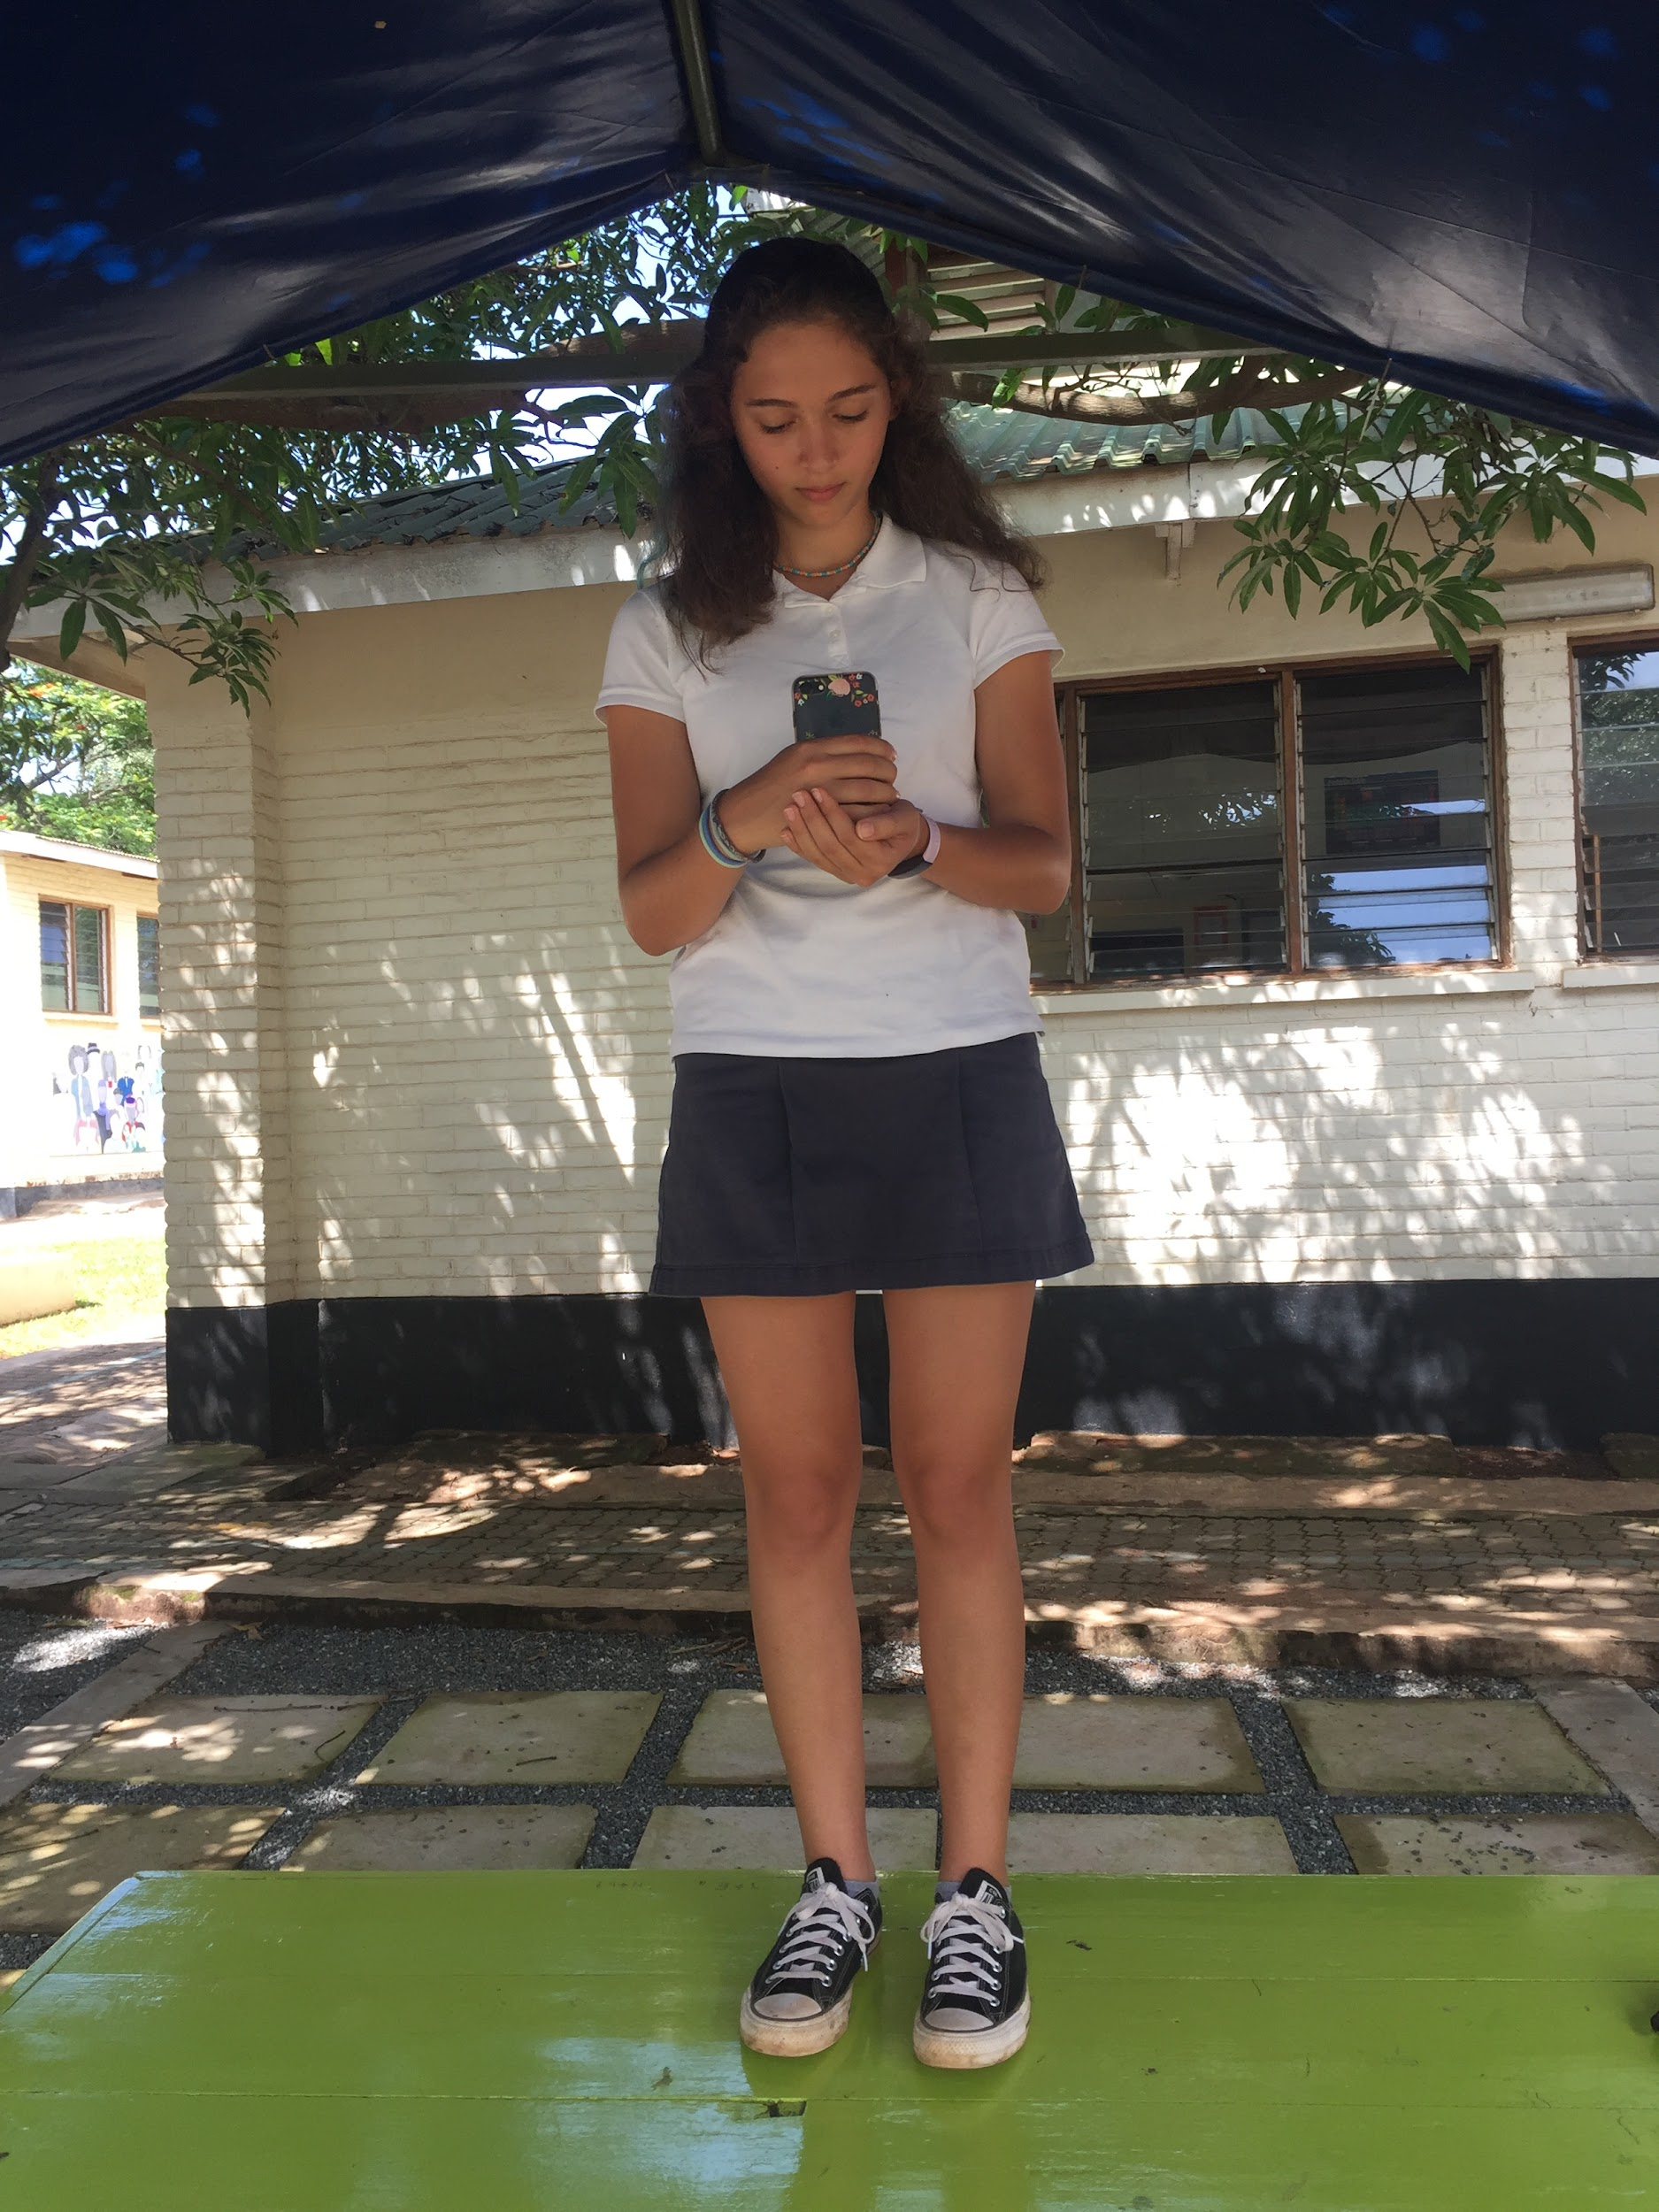
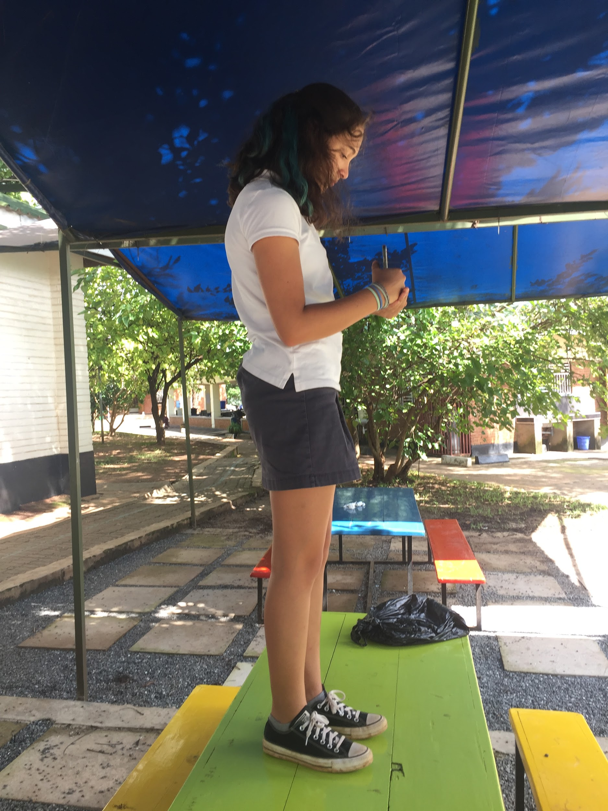
Religion/ceremony
How will you use human form to do this?
By using human form I will have my sculpture standing with its head slightly bowed, looking at the candle. It’s arms will be in front of it holding a candle and it’s hands will be cupped around it. I will also incorporate angel wings that will be on the back of the sculpture.
What message do you want to communicate?
I want to communicate a message of new life and love. When my sister and I were christened, at the ceremony everyone was holding candles. The candle symbolizes new life and a bright future. I think it also means love because on that day you are surrounded by everyone who loves you. I like looking back at pictures from then and seeing how happy everyone is and I hope this statue can portray that.
What materials will you use to create this?
To show this message I will get and actual candle and incorporate it into the sculpture. I will also include angle wind that have rose petals stuck to them because roses symbolize love.

Slide 17
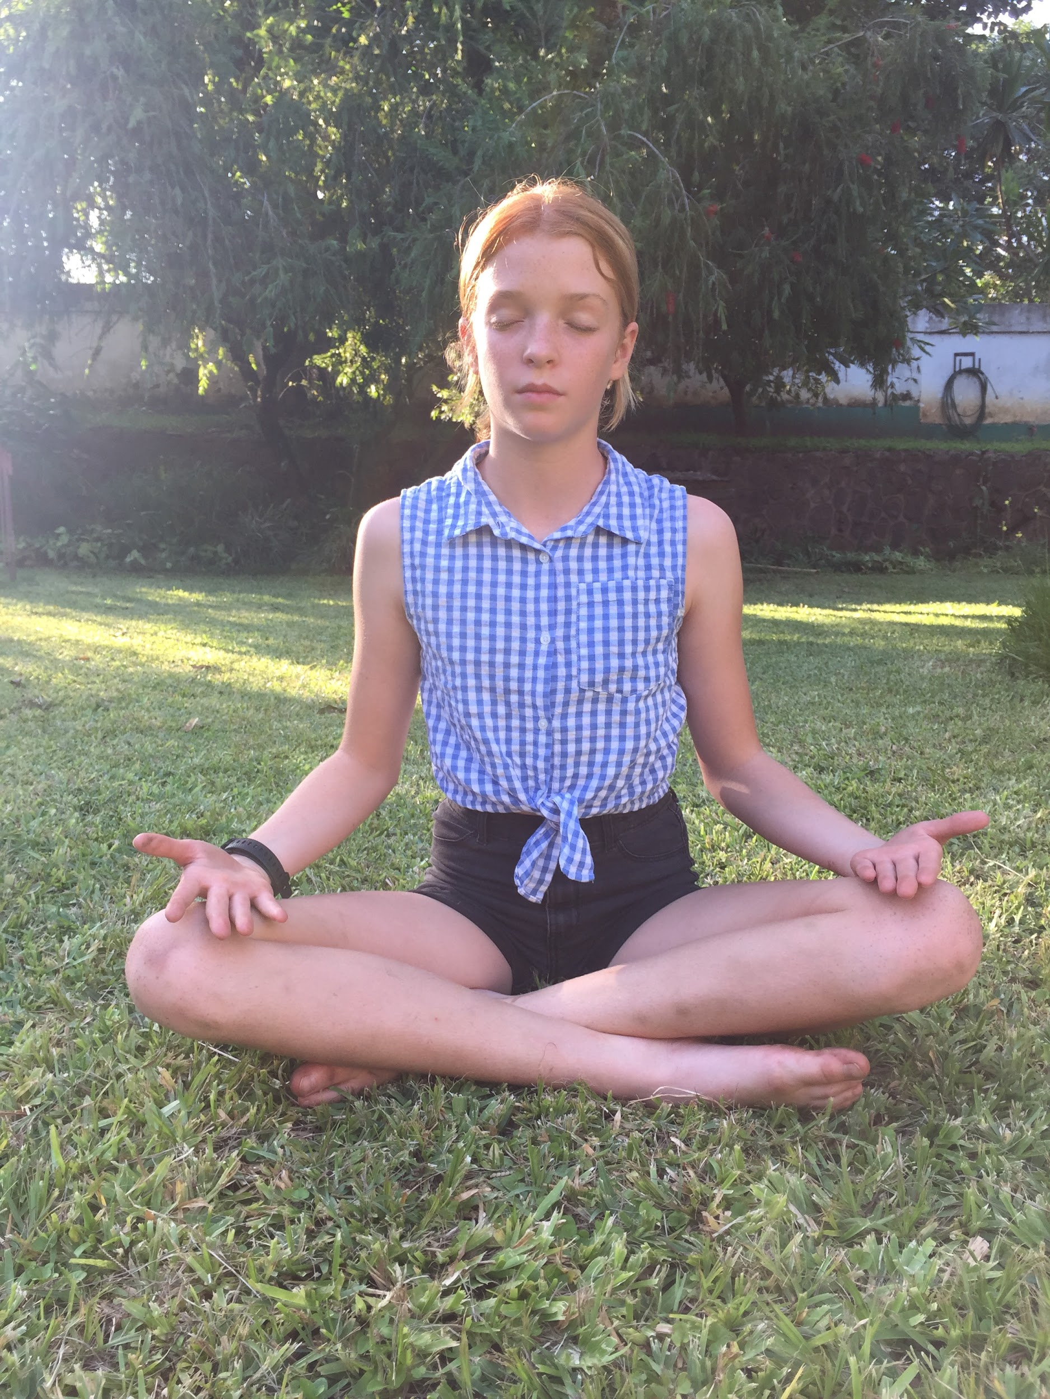
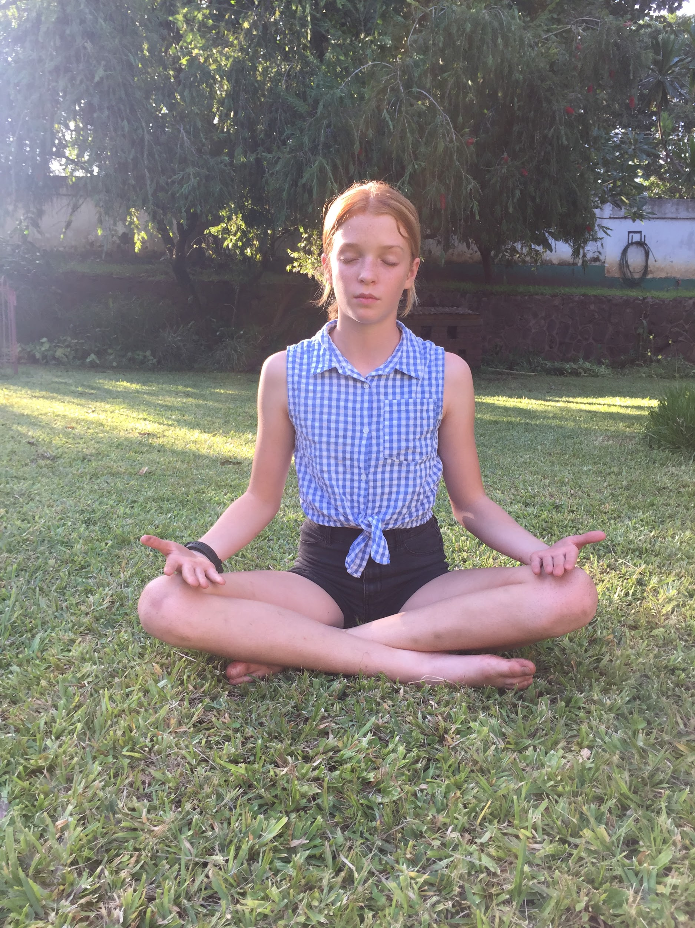
Educate
How will you use human form to do this?
By using human form I will have the statue sitting in a meditation pose- legs criss cross applesauce, arms relaxed and hands open on its knees and it will be sitting up straight. I will also use wings to show the freedom and how they are so calm they could fly away.
What message do you want to communicate?
I want to communicate a message of freedom and peace to teach people about how important good mental health is. People suffer from huge amounts of stress and it’s very important to relax and let it go. It’s good to meditate, talk to someone about it, and to do yoga. I want to teach people how important it is to release that stress and be free.
What materials will you use to create this?
To represent the calmness I will use cardboard to create wings and stick feathers on it because feathers are a symbol of peace and calmness.

Slide 18
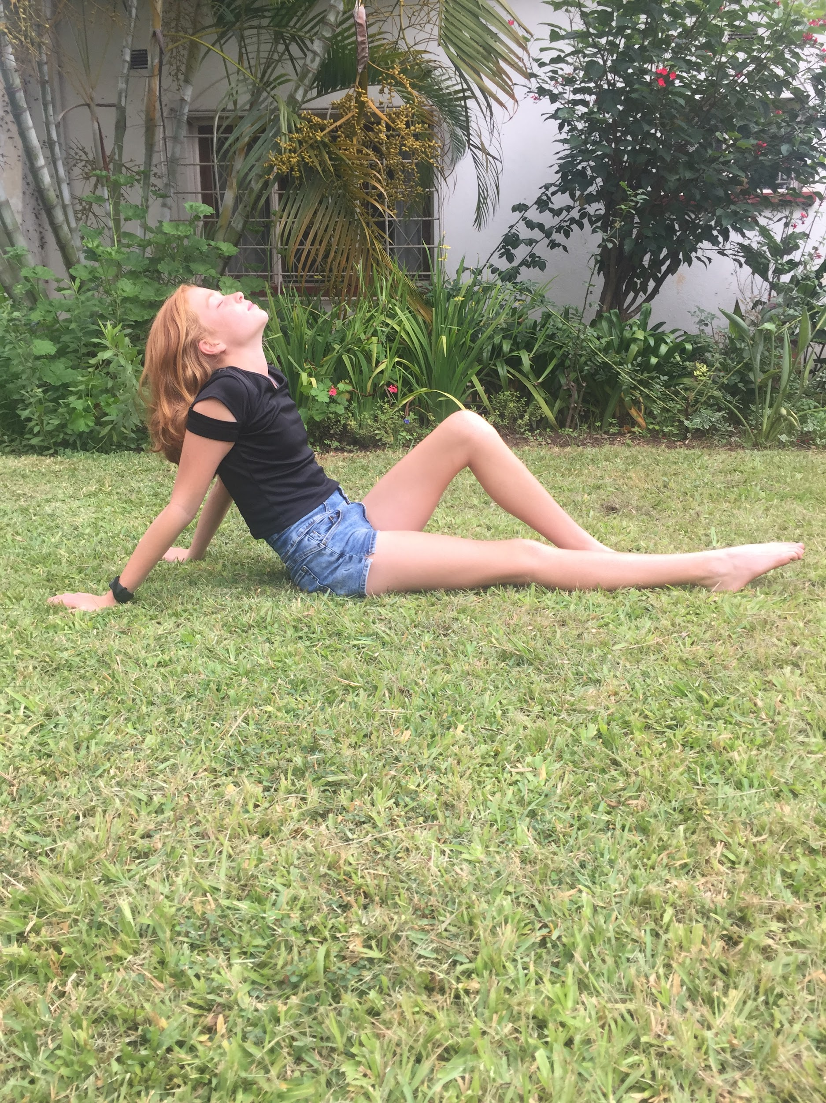
Representation
How will you use human form to do this?
The position my sculpture will be in is a position that makes it look free and peaceful. It’ll be sitting on the ground with its arms back for support, one leg will be straight and the other will be bent, and it’s head will be tilted up looking at the sky
What message do you want to communicate?
Through this sculpture I want to show my love for nature and how important it is. I really love the wild and I think it’s important to care for it. I want to show others they can love nature too and they should look after it. I hope this piece can make others see just how beautiful nature is!
What materials will you use to create this?
I want to use natural materials like sticks, leaves and flowers. I hope it’ll look great in the end so people can see nature’s beauty!

Slide 19
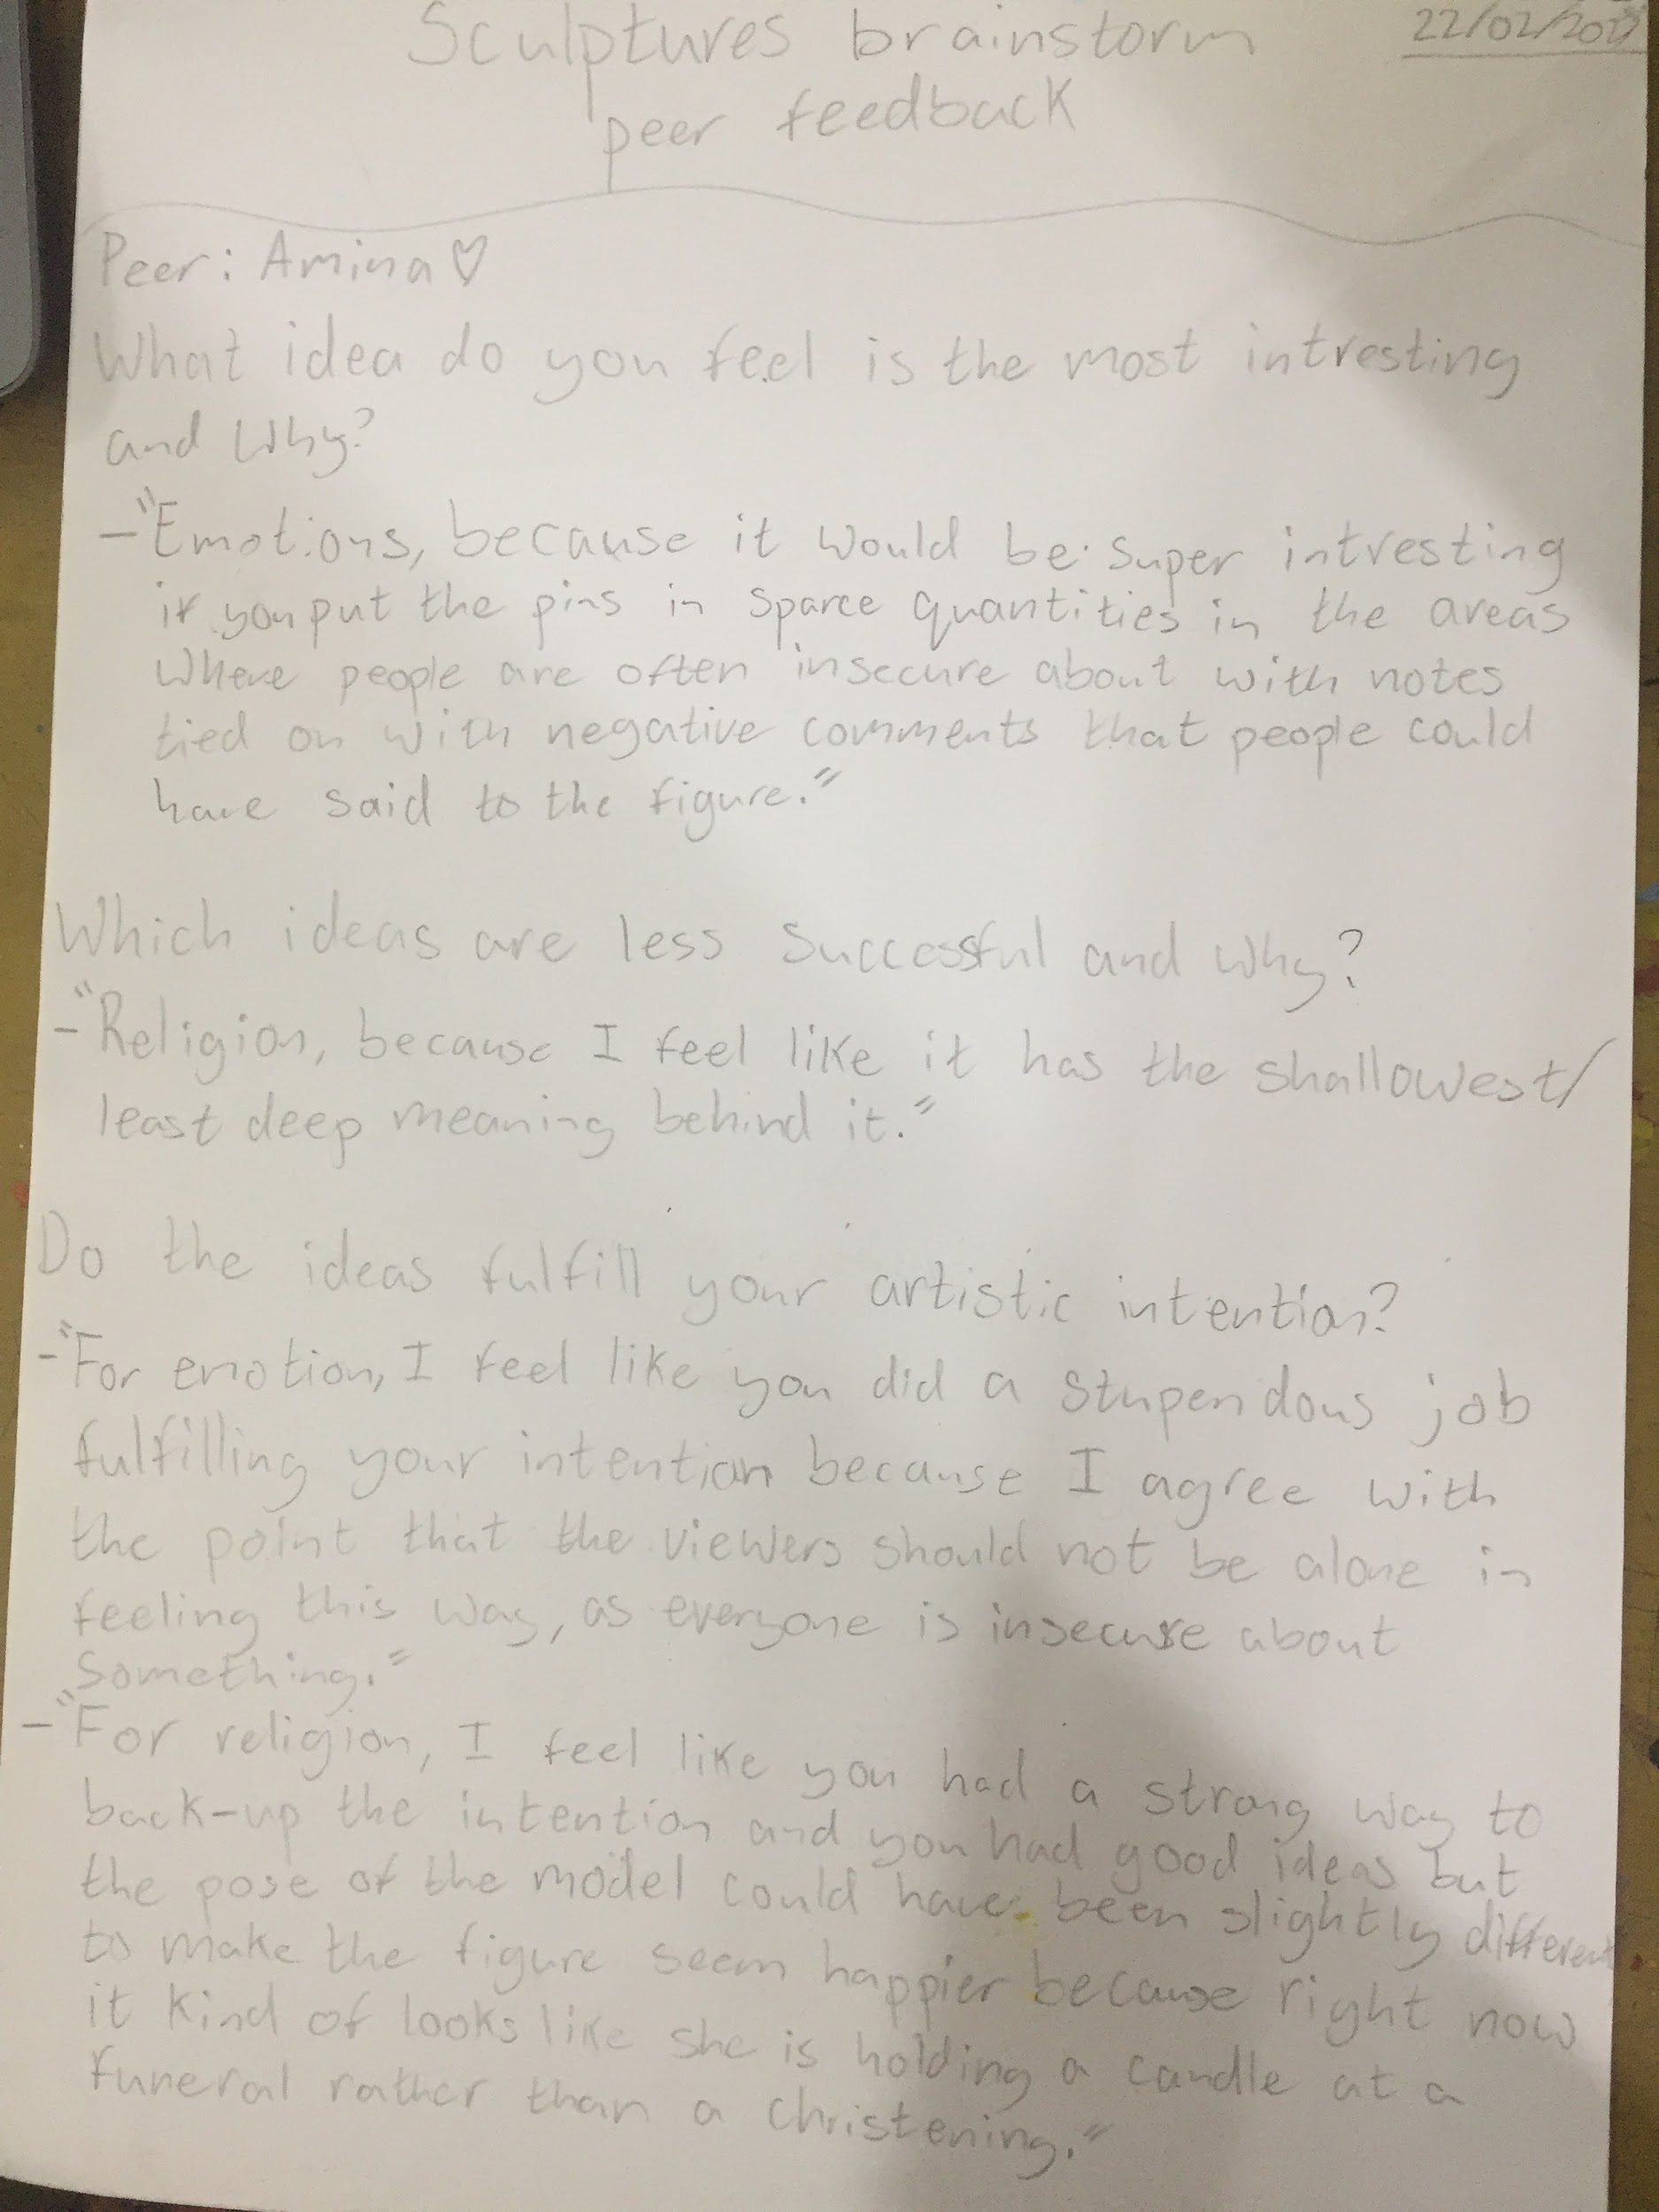
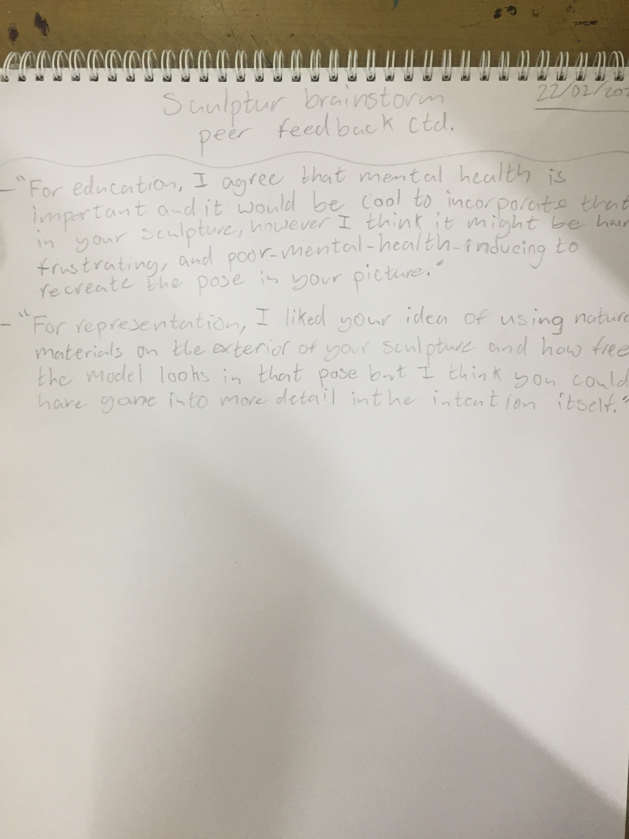
Sculpture brainstorm peer feedback

Slide 20
Final chosen sculpture position

Slide 21
Reflection on final choice
Why did I chose this sculpture?
I chose this sculpture because I think it has a really important message behind it and it’s a very creative idea. My peer also agreed that it was her favourite idea and thought that everyone should know about it. I believe that this message should be spread because no one should feel insecure about themselves because of what someone else says. They’re probably only saying that because their insecure about something in themselves.
Did I make any changes?
First I came up with the idea of having insults and negative comments written on pieces of paper and attaching them to the pins but then Ms Blessings and I were discussing my sculpture and we came up with the idea to go around asking girls about any negative comments that someone said to them that made them feel insecure and using those comments for pieces of paper. I would keep the notes anonymous so no one knows who the comment is about and is rude to them.

Slide 22
Art process

Slide 23
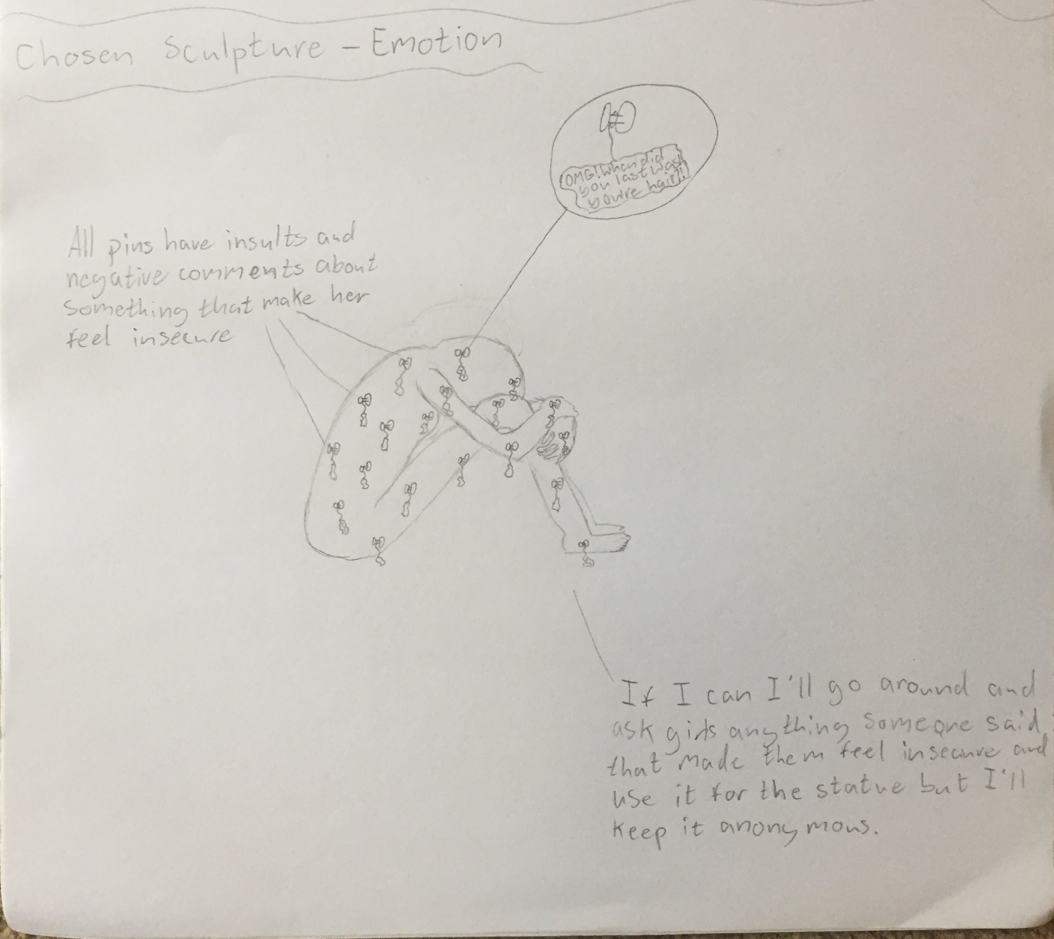
Sculpture planning
To make the sculpture I am planning on making it out of styrofoam and either paper mache or plaster of paris to give it some strength. I’m going to use styrofoam because hopefully I can carve into it and create the body parts of the sculpture. Then I would cover it in either paper mache or plaster of paris and stick the pins into it with the comments tied on. I want the actual body of the sculpture to be plain white but the pins different colours so they can stand out from the white.

Slide 24
https://drive.google.com/drive/folders/1kgUJ5FLazuqZXXl5-YCRpcjf0JZr9kY0?usp=sharing
Link to building of the sculpture process pictures
(Because there are way too many to put them on the slides!)

Slide 25
Insults and negative comments
Comment | Paper colour | Pin colour | Done
No one likes you | Blue | Red | x
Are you really going to eat all that? | Yellow | Blue | x
You can’t do anything right! | Red | Green | x
Why do our teeth look like that? | Green | Yellow | x
Why do you act like that? | Orange | Green | x
You look like a before picture | Green | Blue | x
Get a life | Blue | Yellow | x
You’re a nerd | Yellow | Red | x

Slide 26
Insults and negative comments
Comment | Paper colour | Pin colour | Done
You’re so annoying | Red | Yellow | x
You’re really ugly | Orange | Green | x
You let everyone you know down | Yellow | Blue | x
You’re as flat as an ironing board | Green | Red | x
You look different, how much have you been eating? | Blue | Green | x
Yeah you’re pretty but have you seen _____ | Orange | Yellow | x
What are you wearing? | Red | Green | x
You’re so fake | Green | Yellow | x

Slide 27
Insults and negative comments
Comment | Paper colour | Pin colour | Done
No one would ever date you | Blue | Yellow | x
Omg your acne is out of control! | Orange | Green | x
You should really wear makeup | Yellow | Blue | x
When was the last time you shaved? | Red | Blue | x
You’re forehead is the eighth continent | Green | Yellow | x
Your so dumb, you can’t understand anything | Orange | Blue | x
Grow up | Red | Yellow | x
Why are you so tall? | Blue | Red | x

Slide 28
Insults and negative comments
Comment | Paper colour | Pin colour | Done
Nothing brightens up the room like your absence | Yellow | Green | x
You look like something I drew with my left hand | Green | Blue | x
Don’t stand too close to the heater, plastic melts | Red | Green | x
What’s wrong with you? | Orange | Red | x
You’re such a failure | Blue | Yellow | x
Why would we want you to come? | Green | Red | x
If I had a face like yours, I’d sue my parents | Yellow | Green | x
What’s up with your hair? | Red | Blue | x

Slide 29
Process steps

Slide 30
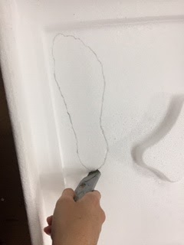
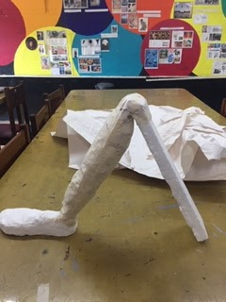
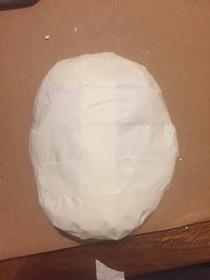
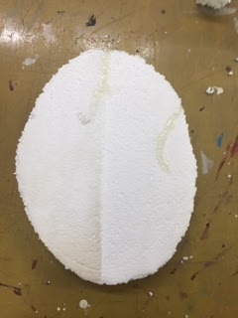
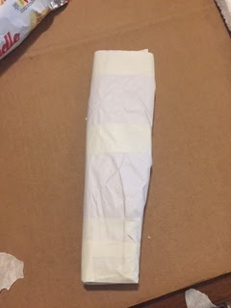
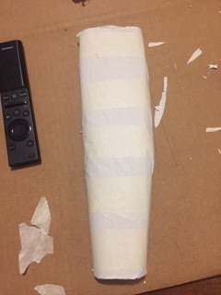
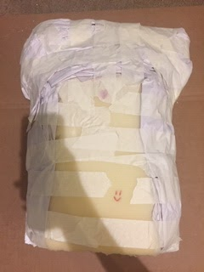
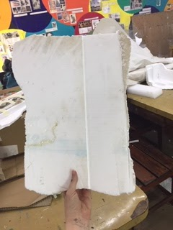
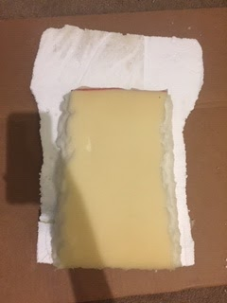
Building the body parts
First I had to build my body parts. To do this I would get some styrofoam trace around a part of my body. Then once I had a clear outline I would cut the shape out. After that I would give it shape by padding it with paper and taping it down till I had a good shape. To make the back look hunched over I cut out a piece of foam and glued it to the styrofoam cut out.

Slide 31
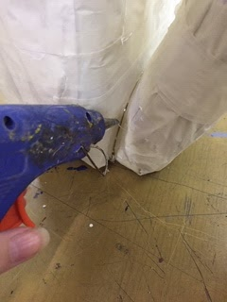
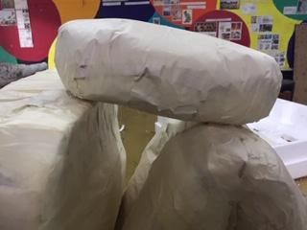
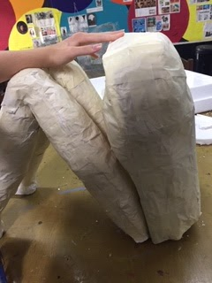
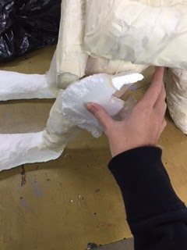
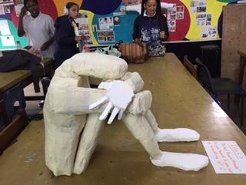
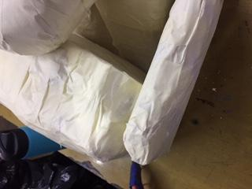
Attaching
After I had built all the body parts I attached all of them together with hot glue. First I attached both legs to the torso. Then I attached the head to the top of the torso and balanced it on top of the knees. I then built a neck so the head wouldn’t look like it’s floating. Then I attached upper part of the arm to the shoulders and the lower part of the arm to the upper part. Finally I attached the hands to the the wrists.

Slide 32
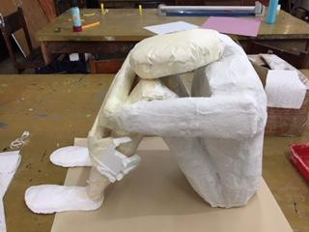
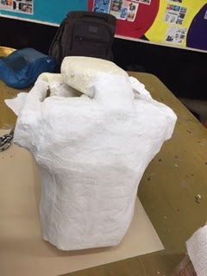
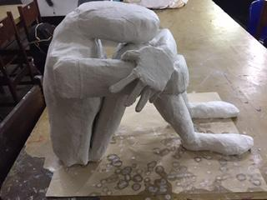
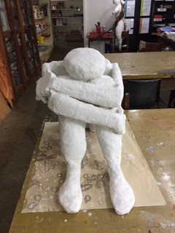
Plaster
Once I had attached everything I plastered it all because it would give it more strength and I wanted a plain white background so the colourful notes would stand. To plaster something you have to cut the plaster to the size you want it and then soak it in water for a few seconds. Then place it on the part you want to plaster and rub it so the holes get evenly covered.

Slide 33
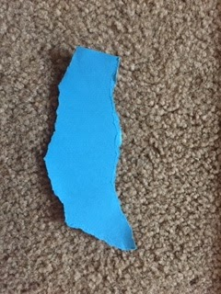
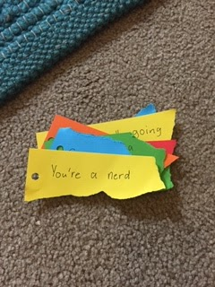
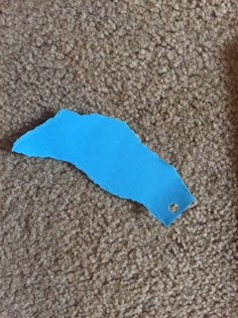
Notes and pinning
For the notes I got pieces of coloured paper and I tore piece off and wrote on them. I got the insults or mean comments either from the girls in year 9, ones I’ve hear or that I have received. To make each note I tore a piece of paper, punched a hole in it and then wrote on it. Once all the notes were made I got pins and tied them together. Finally I stuck all the pins into my sculpture.

Slide 34
Final outcome

Slide 35
Reflection on outcome
I’m so proud of what I managed to achieve! It turned out almost exactly how I wanted it to! If I were to change anything I would have made the head rounder and make the upper arms look more like they were attached to the shoulder because they look like they have weird shoulder dips. But other than those few things it looks really good. I managed my time really well and was committed to finishing it. I took it home when I needed to so I could finish it and worked on it a lot at school as well. This was quite stressful but I’m very happy with the way it turned out!

Slide 36
BTW, my sculpture is in the art room under the side work platform with a back plastic bag over it for safety. Thanks so much for all you’ve done for us Ms Blessings! This Art rotation has been so fun and I can’t wait to see you next year (I’m 95% sure I’m choosing art)!

